Slide 1
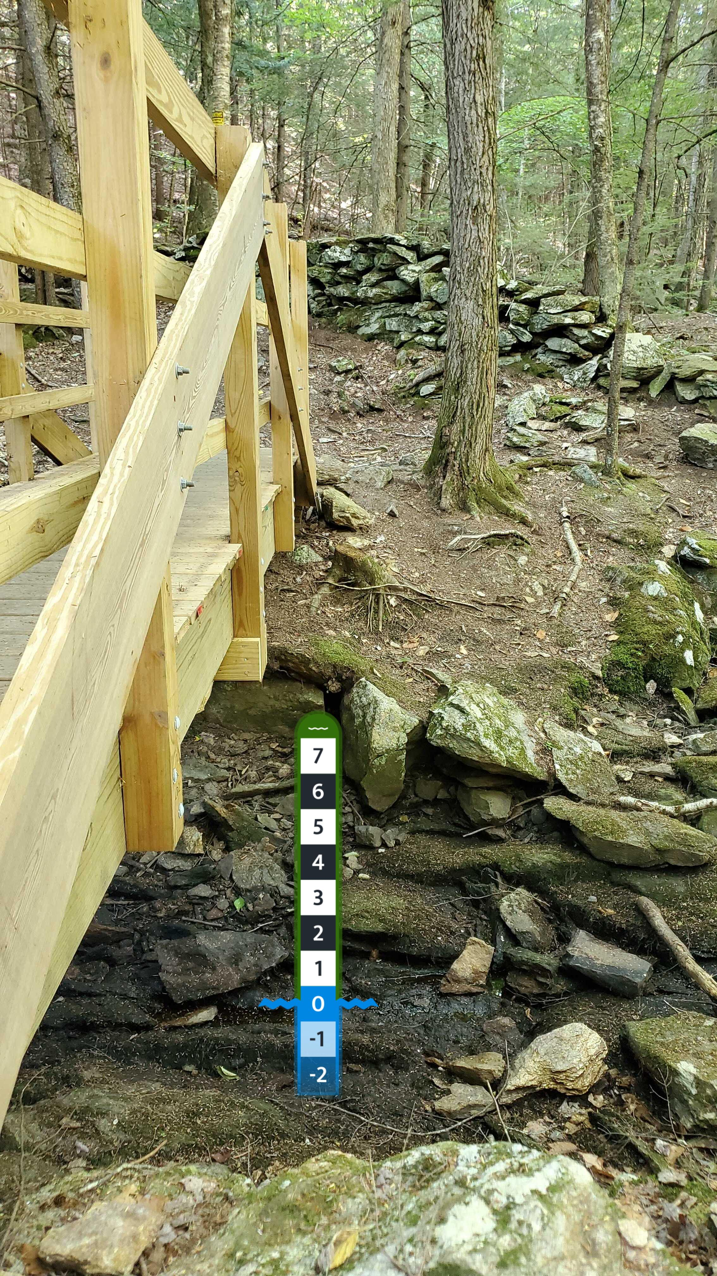
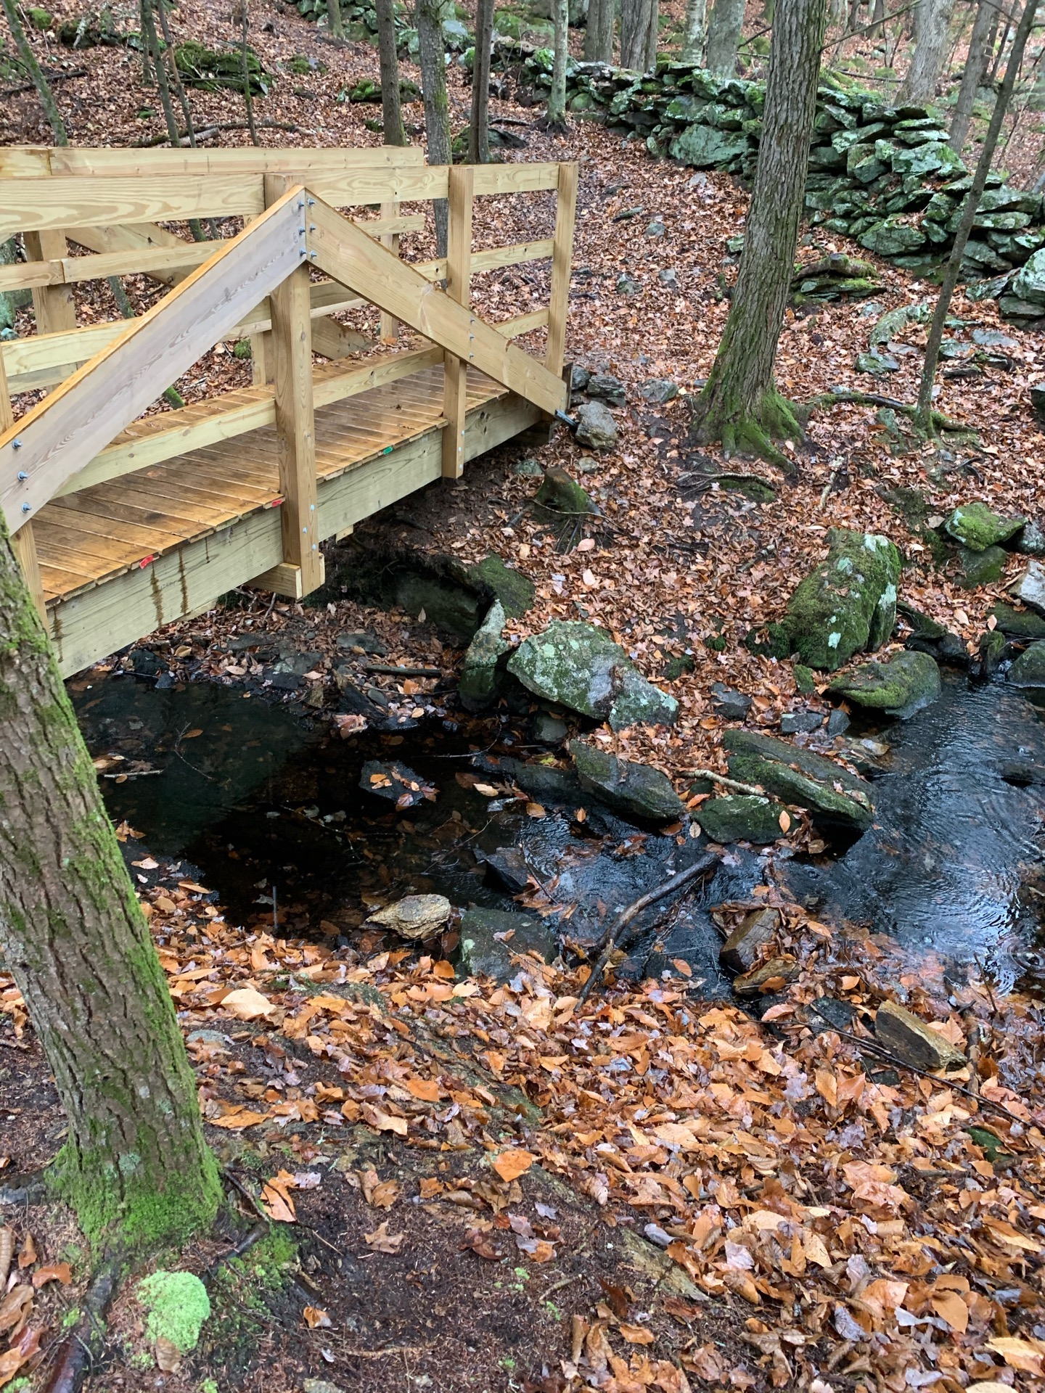
Pulpit-1
Notes:
+4

Slide 2
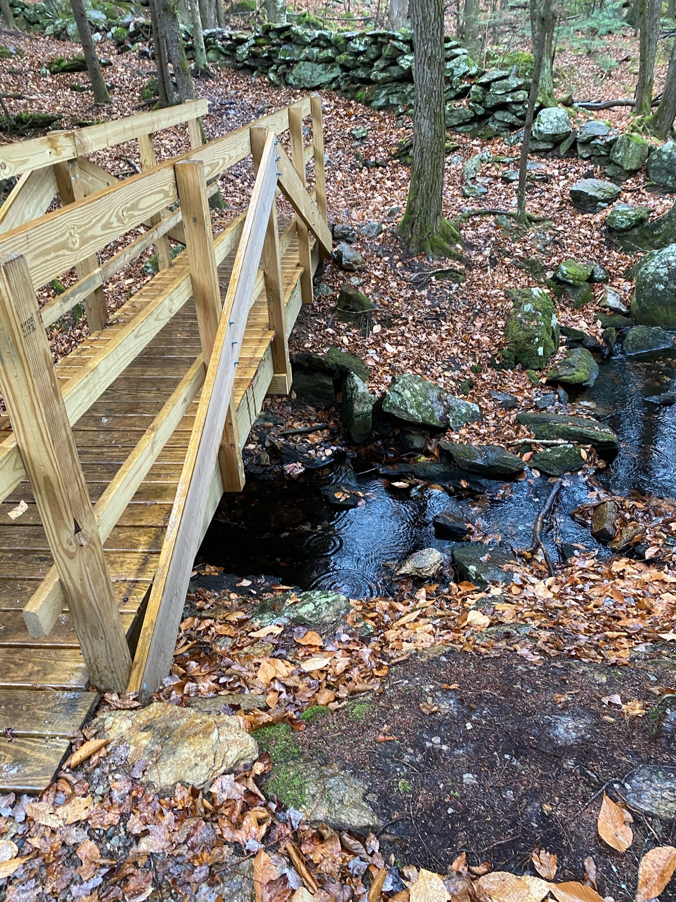
Pulpit-2
Notes:
+4

Slide 3
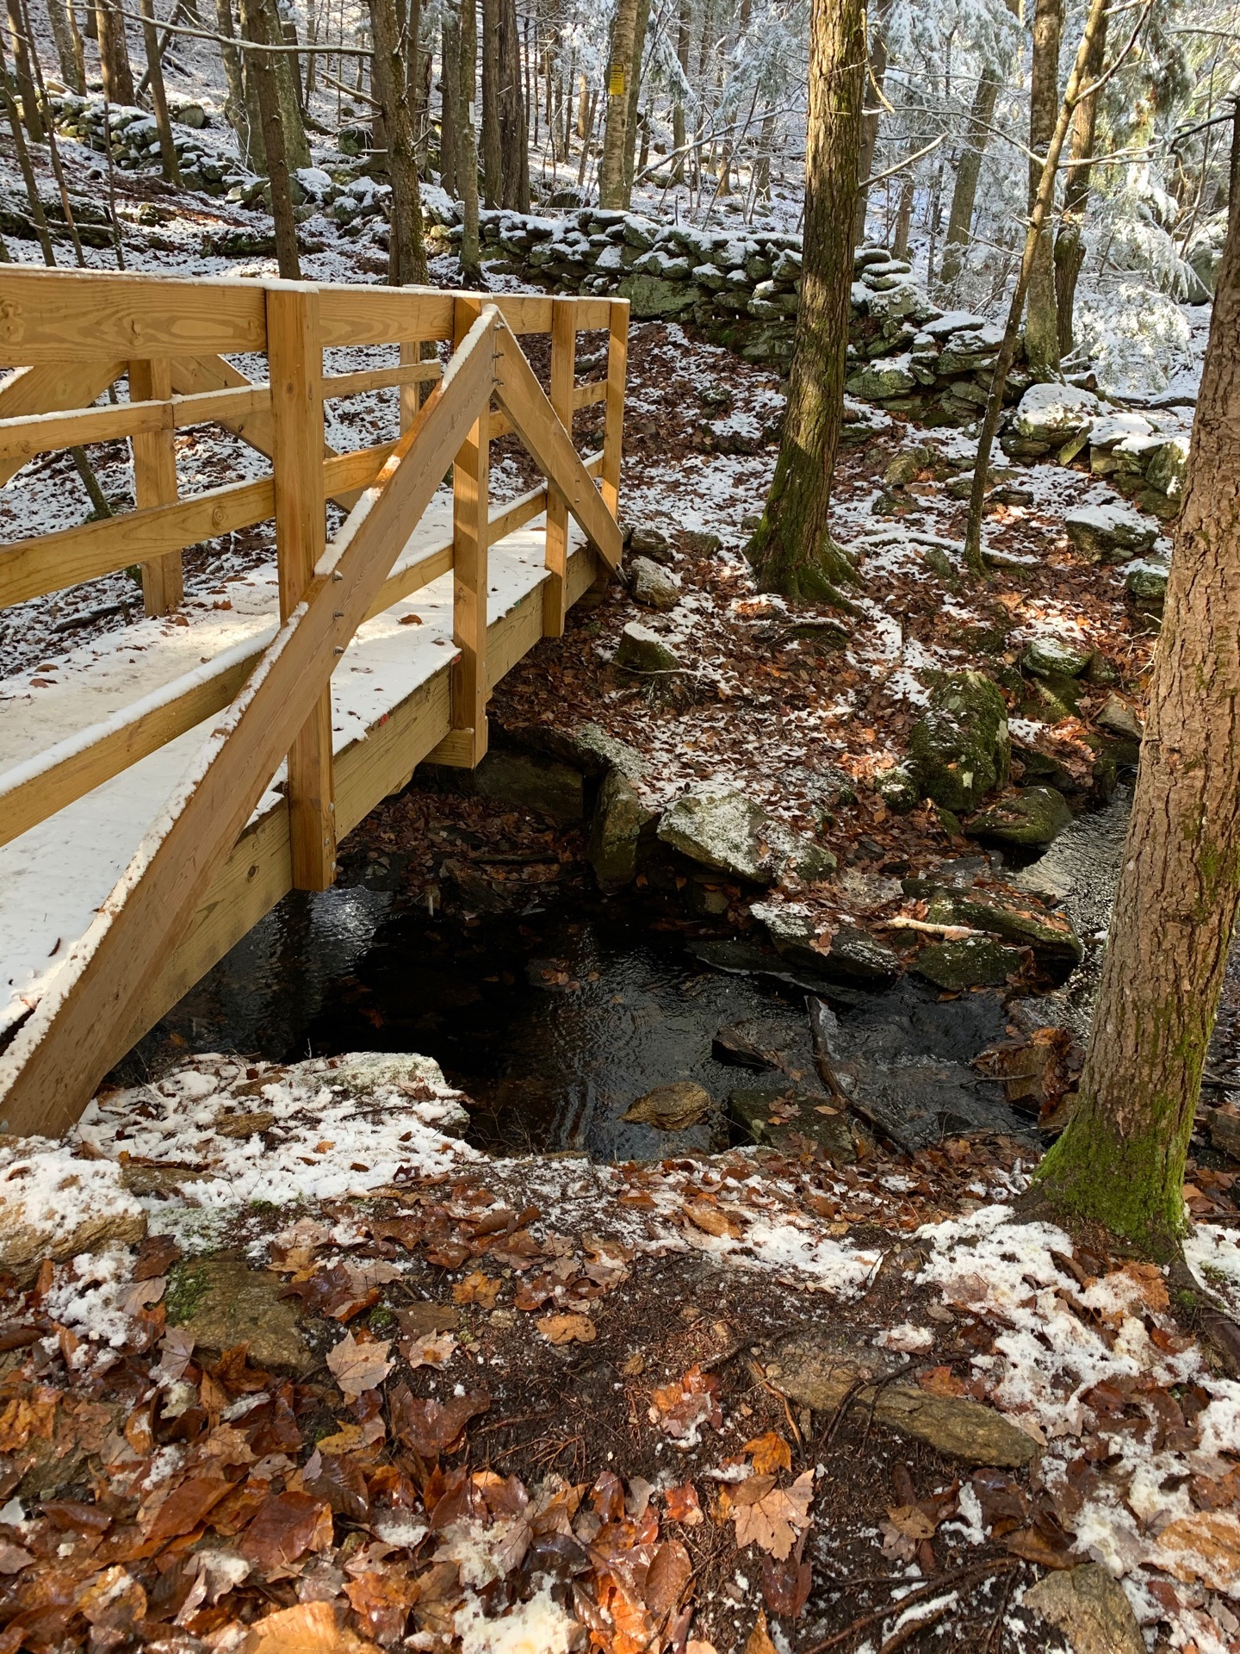
Pulpit-3
Notes:
+4

Slide 4
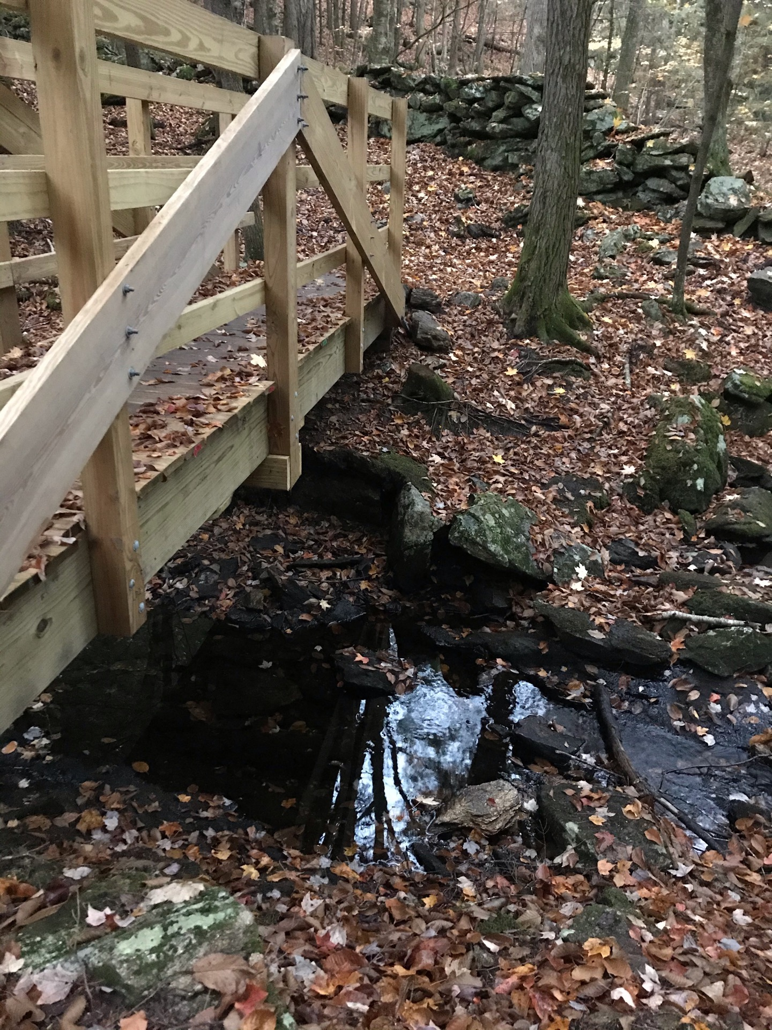
Pulpit-4
Notes:
+2

Slide 5
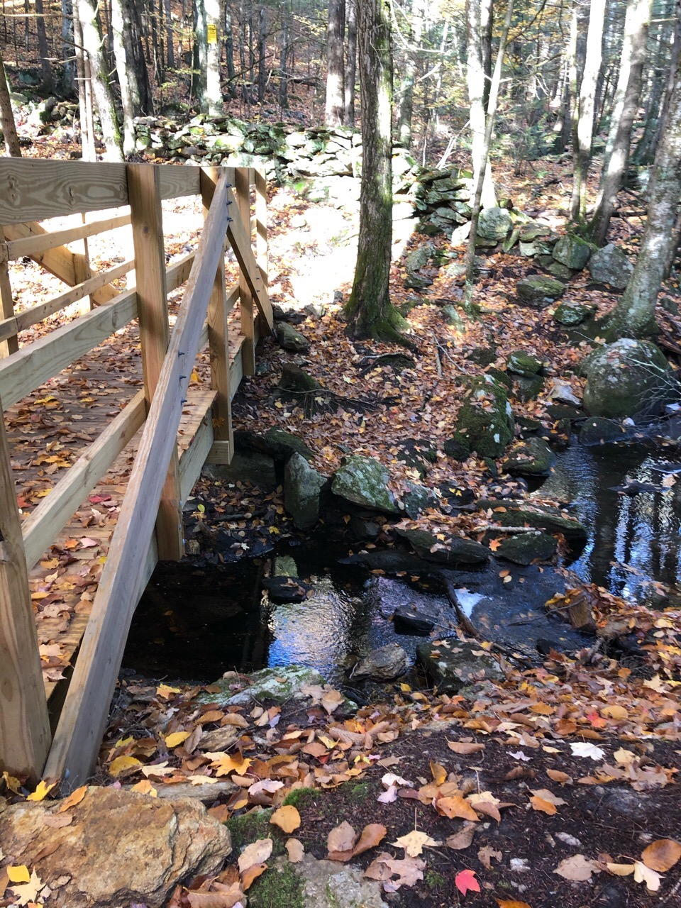
Pulpit-4
Notes:
+2

Slide 6
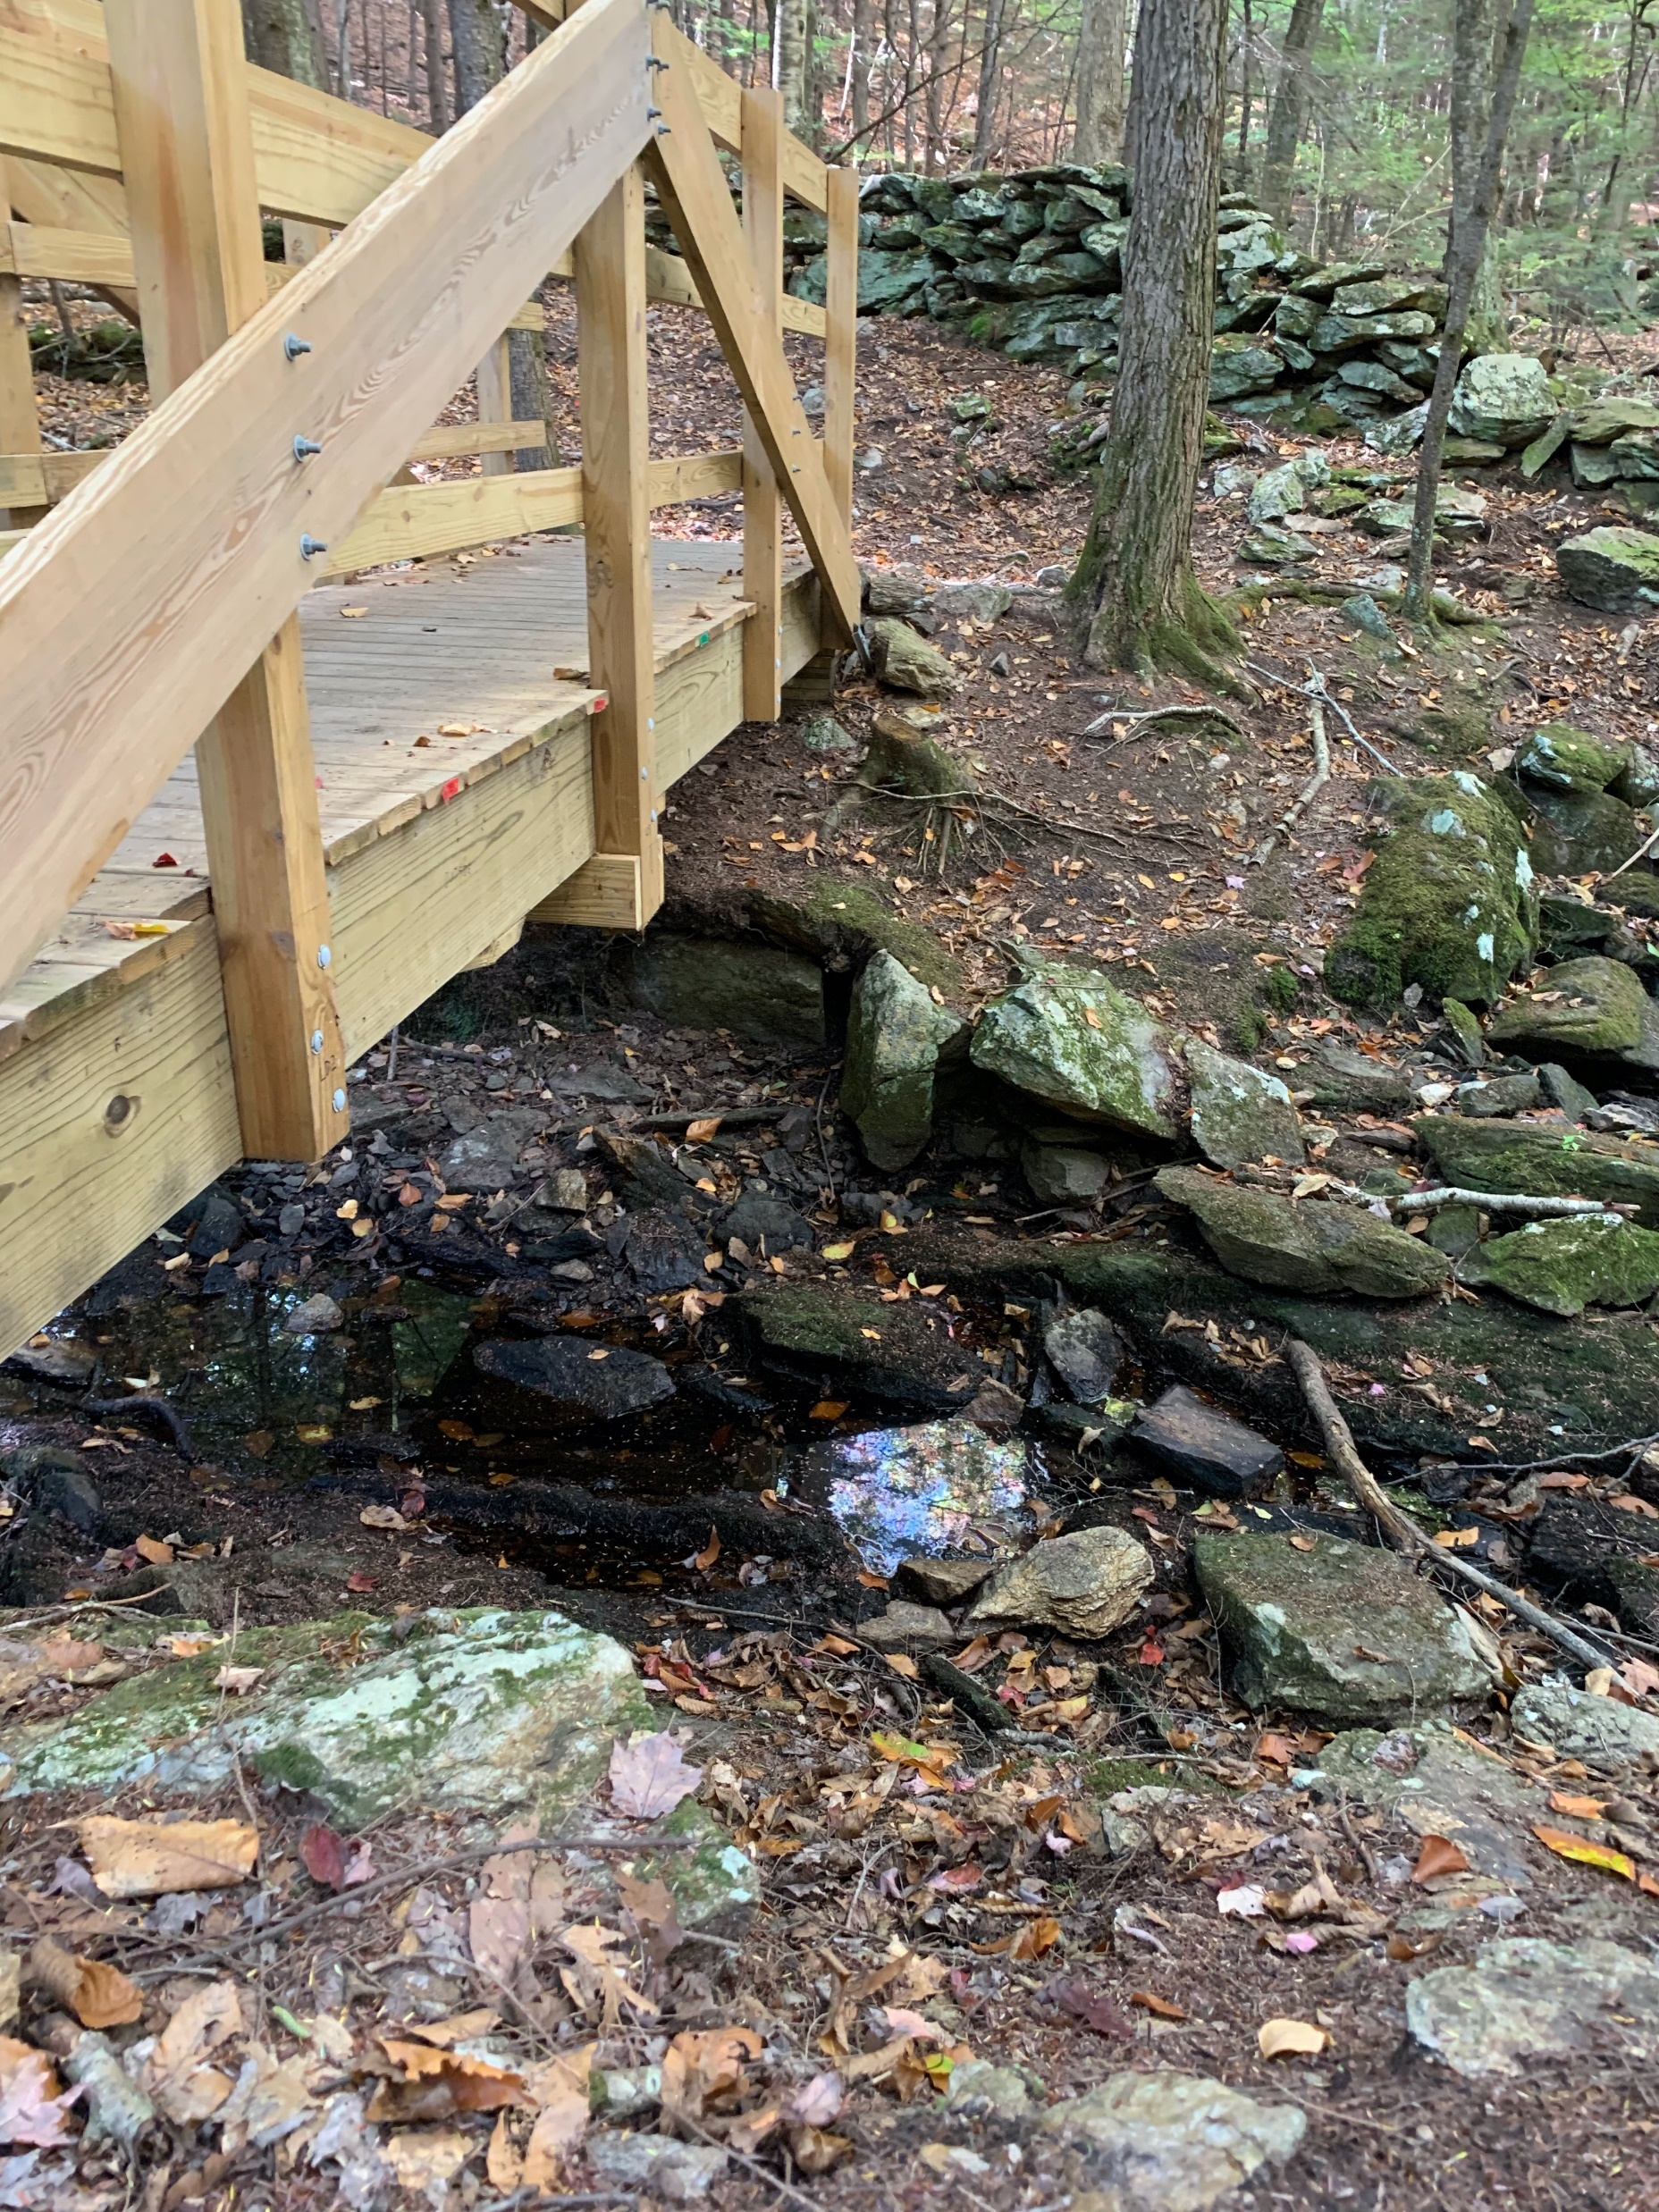
Pulpit-5
Notes:
+1

Slide 7
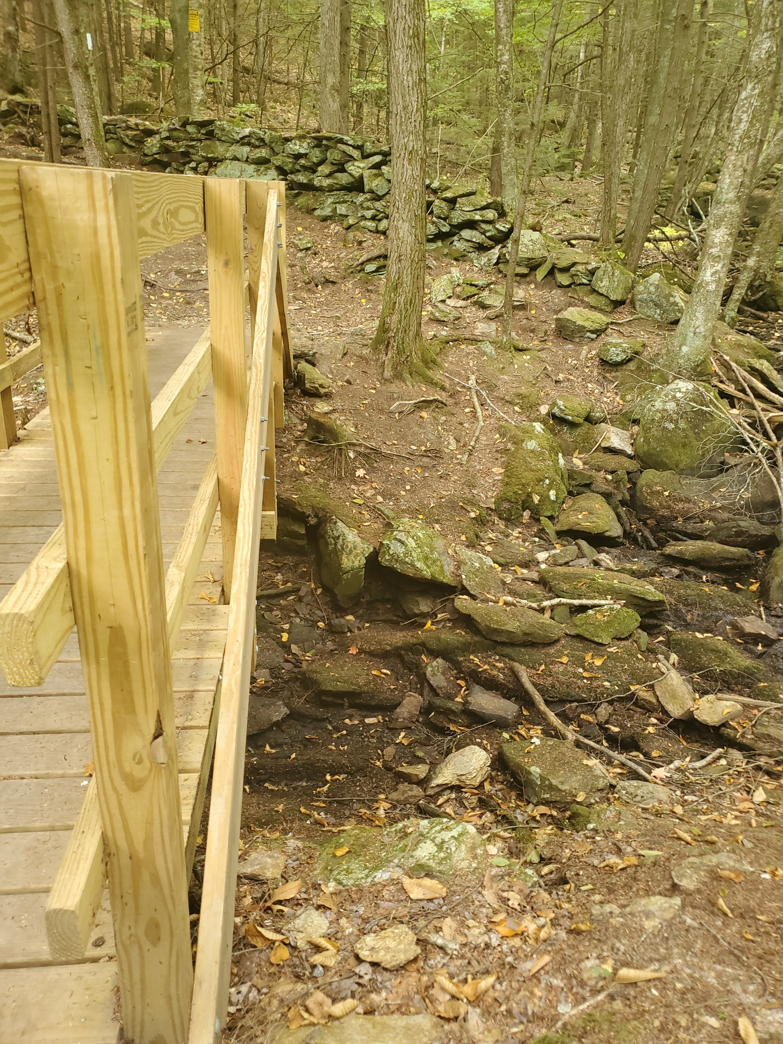
Pulpit-6
Notes:
0

Slide 8
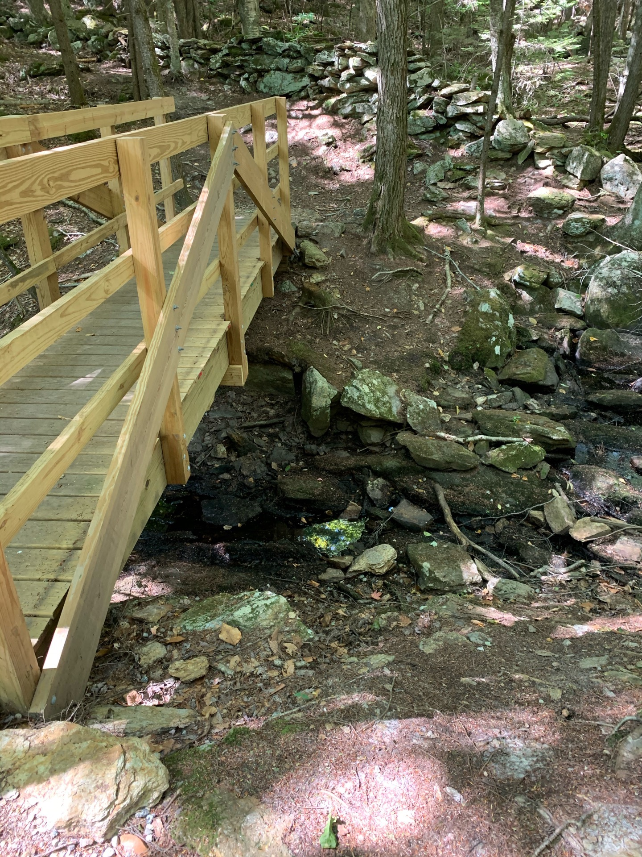
Pulpit-7
Notes:
+1

Slide 9
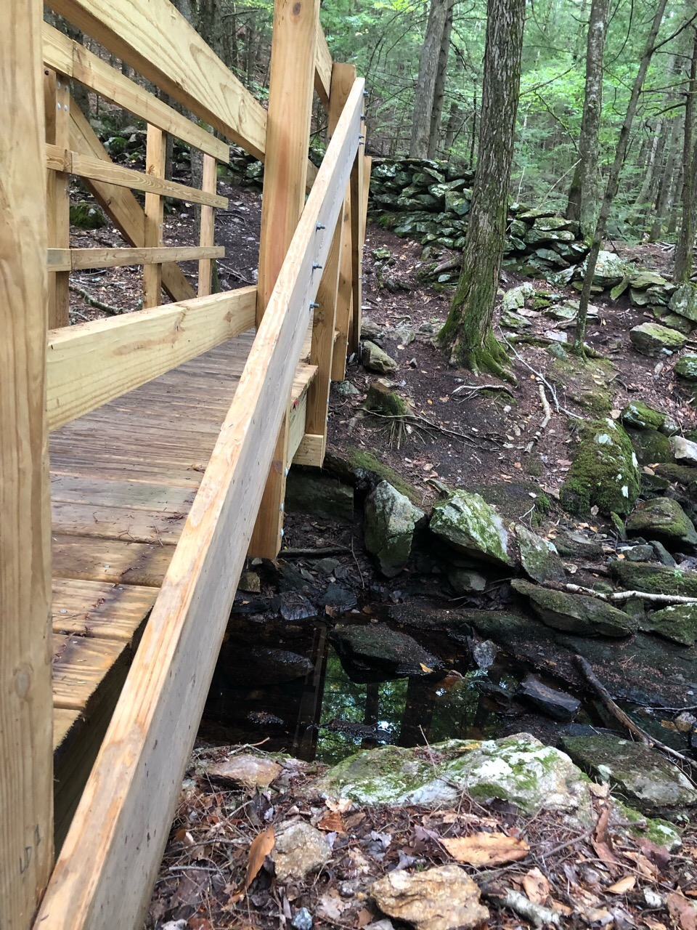
Pulpit-8
Notes:
+3

Slide 10
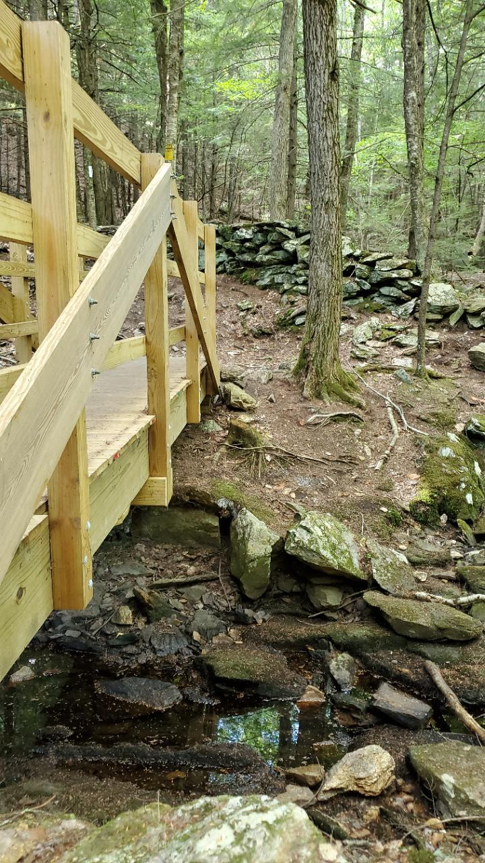
Pulpit-9
Notes:
+1

Slide 11
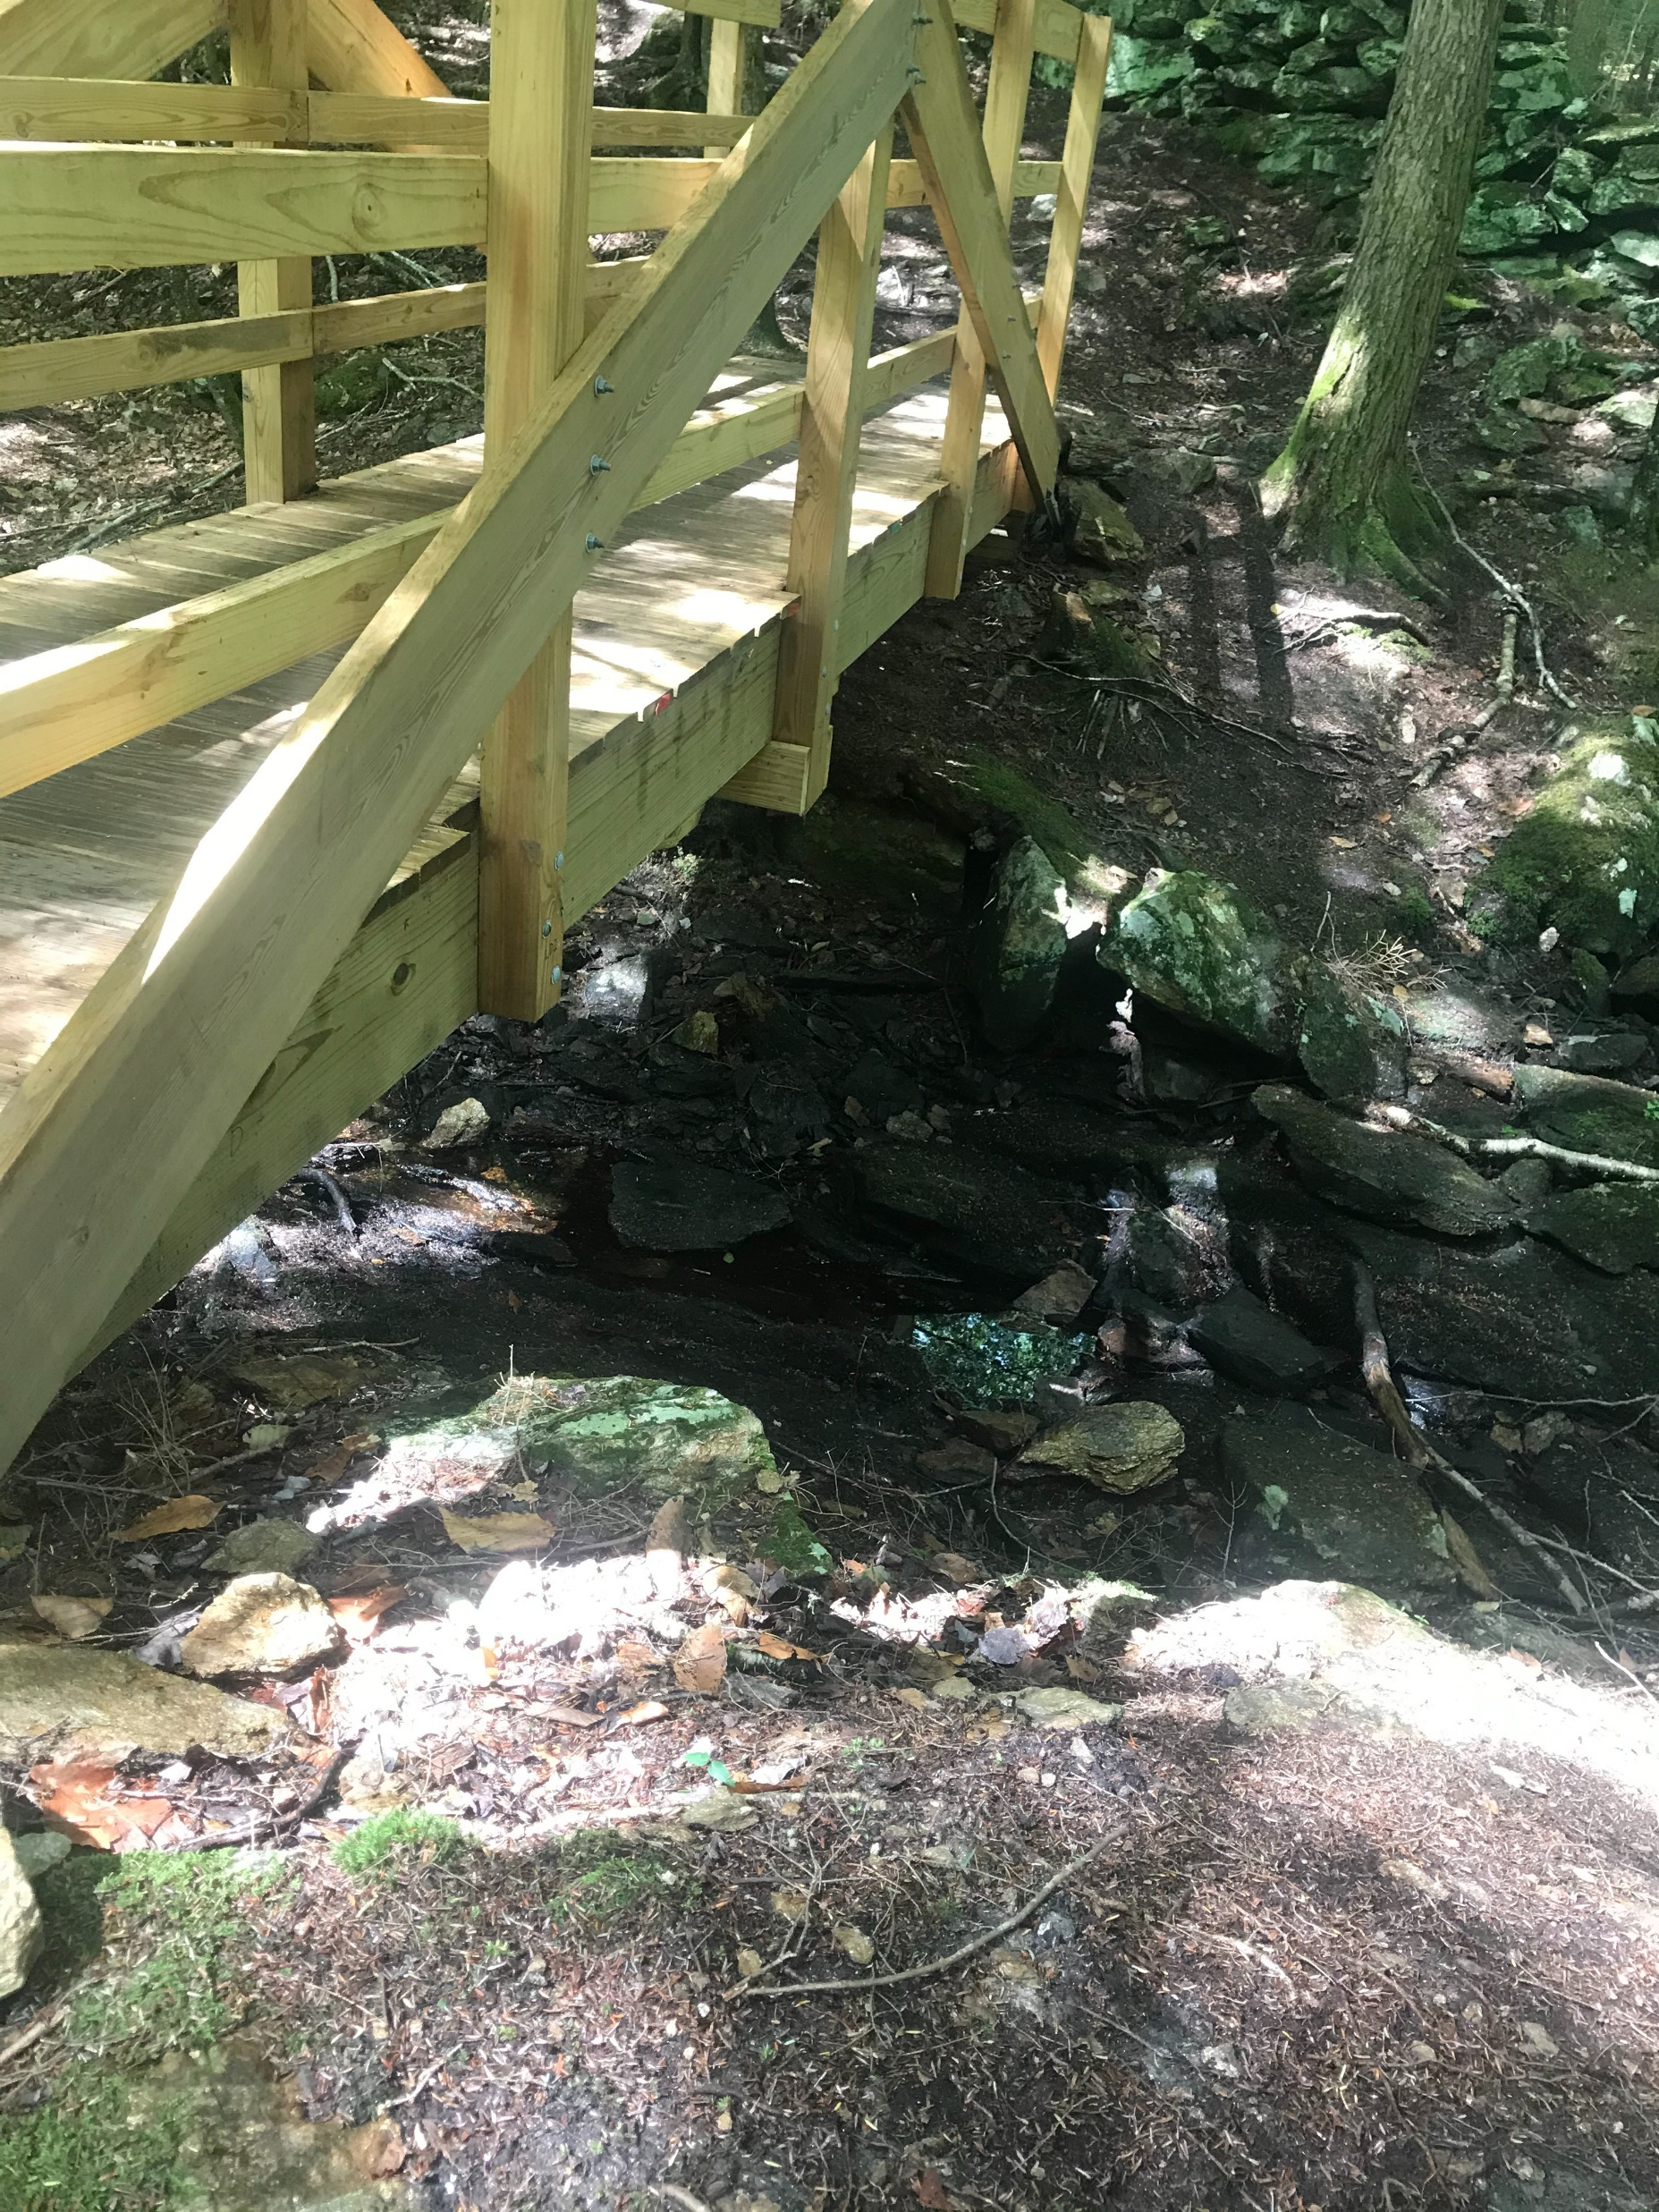
Pulpit-10
Notes:
+1

